Slide 1
EKITI STATE UNIVERSITY ACADEMIC SUMMIT
A PAPER PRESENTED BY THE DIRECTORATE OF ACADEMIC AFFAIRS
DIVISION OF THE REGISTRY

Slide 2
PROTOCOL
INTRODUCTION
The Directorate of Academic Affairs is the engine room of the university system particularly on Academic matters. The office is always busy with one assignment or the other throughout the year.
The officers posted to the Directorate are carefully selected from crops of dedicated and hardworking staff.

Slide 3
Considering the sensitivity of some of the functions performed by the Directorate, people of integrity and hard work are required to work on very sensitive assignments; starting from Admission of students, Verification of results, Registration/Screening of students, Issuance of Notification of results, Transcript and Certificates.

Slide 4
The Directorate of Academic Affairs is divided into three divisions namely:
Admissions Office
Examinations and Records
Senate and Academic Matters

Slide 5
DIRECTORATE OF ACADEMIC AFFAIRS
SWOT ANALYSIS
STRENGTH
The strength of the Directorate is the availability of highly qualified staff who are trustworthy, dedicated, loyal and hardworking. They are people of integrity.
The location of the University is another of its strength the University is accessible and linked to all major road networks in the country.

Slide 6
WEAKNESS
Inadequate office space /Accommodation problem.
- Lack of adequate facilities and tools to work with.
- Poor internet facilities – It is difficult to send mails and report to senate members.
- Lack of storage facilities and poor storage system.
- Non availability of some vital documents.
- Absence of utility vehicle to circulate bulky folders of senate and distribute vital mails.

Slide 7
OPPORTUNITIES
The school fees are moderate when compared with the school fees paid in private and public institutions around.
- Availabilities of qualified candidates to draw from to fill the admission vacancies.
- Certificates are ready for collection during graduation ceremony.

Slide 8
THREATS
Incessant strike actions which disrupt academic calendar in the University.
- Policy of regulatory bodies such as JAMB, NUC and State government,
- Negative public image about transcript issuance and delay in release of result.
- Certificate forgery
- Funding of the University has hampered the development of the University
- Students agitations and restiveness.

Slide 9
General challenges
The Directorate is confronted with serious accommodation problems, all the Divisions in the Directorate are scattered in four locations in the University which made co-ordination of activities in the Directorate difficult for the Head of Divisions. The few rooms allocated to the Divisions in the Central Administrative Building are grossly inadequate to accommodate the staff.

Slide 10
ADMISSIONS OFFICE
The Admission process is normally handled by the central admissions committee consisting of DVC (Academic) as the Chairman, Provost College of Medicine, Deans of Faculties, Registrar, Director of Academic Affairs and the Admissions officer as Secretary. The criteria for admission are set by the committee yearly based on the number and performance of candidates at UTME and JAMB.
The various faculties would consider the list of candidates sent by JAMB with the

Slide 11
post UTME and make recommendations to the central admissions committee in line with approved guidelines. The Admissions Officer would collate and process with JAMB.
Request list from various quarters are treated under the Vice – Chancellor’s discretionary list.

Slide 12
The challenges:
Students’ admission: Low subscription due to:
Competition from other Universities in the catchment area
Perceived high fees compared with federal universities
Delay in processing of admission due to failure to meet deadline for submission of recommended candidates.

Slide 13
Change of course
The non-consideration of admission requirements before offer of admission leads to change of course. The procedure is cumbersome and causes delay.
Shortage of staff (Typist/Data Processing Officer) to input shortlisted candidates.

Slide 14
Registration:
Registration is done manually.
Verification of additional qualifications is usually delayed in the alma-mater of the candidates.
University has not been releasing fund for verification of candidate’s entry result.
Shortage of staff (Data Entry Clerks) for verification of entry results on line.

Slide 15
Accessibility to University Portal:
Poor access to University Portal.
Facilities to make use of the University Portal are not available to relevant officers.

Slide 16
Suggested Solutions
Automation of admission processes using intranet.
Aggregate score should be released to candidates as results immediately after PUTME exercise.
Publishing of cut-off marks on Faculty basis for admission on the University website would reduce undue pressure for admission and fast tract admission process.
Allowing Admissions office to manage the admission interface on the University portal instead of a third party.

Slide 17
Redeployment of two ICT compliance staff to Admissions office to operate the interface.

Slide 18
Students Admissions
i. (a) Admission processing should be with speed
(b) There should be a means of considering candidates admission requirements before offer of admission to avoid the rigorous process of change of course.
(c) Adequate provision of facilities and tools for personnel to enhance speed and effectiveness.

Slide 19
ii. Registration
Registration should be done on line
There should be a means of fast tracking verification of additional qualification of the students’ from their alma-mater.
iii. University should release fund promptly for verification of O’level results
iv. Adequate Personnel should be provided.

Slide 20
Accessibility to the University Portal
The University Portal should be made viable for accessibility to ease registration exercise.

Slide 21
THE EXAMINATION AND RECORD DIVISION
This division has three units namely
Certification unit
Transcript unit
Notification of results unit

Slide 22
CHALLENGES OF THE DIVISION
Non availability of some detailed results in the exams and records division thereby preventing issuance of transcript in good time
Poor storage facility leading to poor record keeping
Disjointed office space location thereby making supervision difficult.
Shortage of staff particularly data entry Clerk, Clerical Officers
Absence of online processing of results where data could be uploaded;
Shortage of staff and office equipment to process the transcript speedily. e.g. The division had 15 data entry clerks in 2010/2011 session but it is now left with only 4.

Slide 23
WAY FORWARD/ SUGGESTED SOLUTION
Processing of examinations results is the responsibility of Departments and Faculties.
The Directorate of Academic Affairs takes custody of results as approved by Senate for processing and issuance of Notification of results, academic transcripts and certificates.
The ultimate is to have on line processing of results where data could be uploaded to process transcripts, notification of results and certificates without delay.

Slide 24
The University would not be able to go online successfully without a data bank. Efforts should therefore be made urgently to recover detailed results that are not available in Exams and Records.
There is need for the Departments and Faculties to remit the details of results approved executively since 2005 to date to the Examinations and Records Division
University Management should urgently take a decision on missing details of results

Slide 25
approved before 1999 when some staff relocated to Akungba
Need to now submit details of results approved by senate in both the soft and hard copies to the Senate and Academic Matters and Examinations and Records respectively
Need to provide back-up hard drive for the Senate and Academic Matters and Examinations and Records Divisions accordingly
Need to forward to Examinations and Records Division the details of supplementary results presented to senate

Slide 26
For record keeping, some students who were graduated in error, had detailed results that are sometimes different from graduating results, e.g. some of them who graduated are still having some outstanding courses in their detailed results. Their CGPA were different from class of degree approved for them.
Detailed result should be properly vetted by department before bringing such to senate for approval to avoid errors in compiling the transcripts when the students need them.

Slide 27
In view of the enormity of the schedule of work in the Division, there is the need to divide the Division into two separate units of Transcripts and Certificate, each to be supervised by an officer not below the rank of a Principal Assistant Registrar
That if necessary data, equipment and personnel are provided for the Division, it is possible to generate transcripts for all students immediately the results are approved by senate.
A big and well-furnished space is required for our alumni who come for collection

Slide 28
of their Certificates and Transcripts, this office should be equipped with Television, Magazines and Newspapers to keep these alumni busy while waiting for the collection of their certificates.
More Junior Staff are required in the Certificate Unit to assist in certificate searching from the store.
The Certification Unit would require the printing of more Certificate formats as we have to start with the production of the graduating students for the next convocation ceremony.

Slide 29
Transcripts should be posted to designated requiring institutions instead of collection by hand which may jeopardise the authenticity/security of the transcripts.

Slide 30
SENATE AND ACADEMIC MATTERS DIVISION
This division has three units namely
Senate Unit
Committee of Dean’s Unit
Business Committee of Senate Unit

Slide 31
Change of course within the University
In the beginning, students were allowed to change their courses at will within the University but it was discovered that some courses were seriously depleted so it was stopped.
Change of course is meant for students whose CGPA had fallen between 0.5 and 0.99 for two consecutive semesters, so the students would earn CGPA withdrawal. They would be allowed to seek transfer to any other department at 200 level following the regulation. All cases would be considered by the Committee of Deans and make recommendation to Senate.

Slide 32
Transfer of studentship from other recognised University
Students who wish to transfer from other Universities would apply through the Registrar and obtain necessary form and satisfy the conditions for transfer like JAMB score, Transcript, letter of attestation, O’level result and good academic standing. The Committee of Deans would consider the applications and make recommendation to Senate.

Slide 33
CHALLENGES OF THE DIVISION
Lack of utility vehicle to distribute Senate folders and mails.
Lack of office equipment like desktop and laptop computers, photocopy machine, Giant Staplers etc.
Lack of internet facilities to send messages on line.
Inadequate Space/Store to keep valuable documents like students records, results from faculties folders, academic gowns, etc.
Shortage of office accommodation for staff and equipment.
Insufficient Stationery items to produce folders for senate and other meetings.

Slide 34
Shortage of staff especially Office Assistants, Clerical cadres and Typists/Data Entry Clerk.
Late submission of results for consideration from Departments/Faculties.
Poor/improper computation and arrangement of results by Departments/Faculties.
Undue pressure from staff, Departments/Faculties to include late results for consideration of Business Committee of Senate and later for Executive approval of the Vice Chancellor

Slide 35
Late submission of papers for consideration by Committee of Deans e.g. late submission of change of course forms; papers for conference attendance requests etc.
Lack of proper advice of students by level coordinators on change of course procedure.

Slide 36
SOLUTIONS TO THE CHALLENGES ENUMERATED
Adequate accommodation, storage facilities and equipment should be provided for staff.
Provision of Utility Vehicle for distribution of mails and senate folders
Internet facility for processing of results should be properly addressed to make it functional
Concerted efforts should be made to make senate meetings paperless
More desktop, laptop computers, photocopy machines required
There is urgent need to employ clerical officers, office assistants and typists for the division. This should be given priority.

Slide 37
Deadline for the submission of papers/results for consideration of senate or Business committee of senate must be strictly adhered to by Departments/Faculties.
Circulation of results and other papers on the floor of senate or business committee of senate should stop to be able to have proper record and better consideration of results.
Faculties/Heads of Departments/Level Coordinators should give relevant and adequate information and counseling to students on rules guiding change of course(s).

Slide 38
Adequate stationeries and office equipment like Giant Staplers, Photocopy papers etc. must be adequately provided.

Slide 39
THE NATURE OF OFFICE CONDITION IN THE ACADEMIC AFFAIRS OFFICE

Slide 40
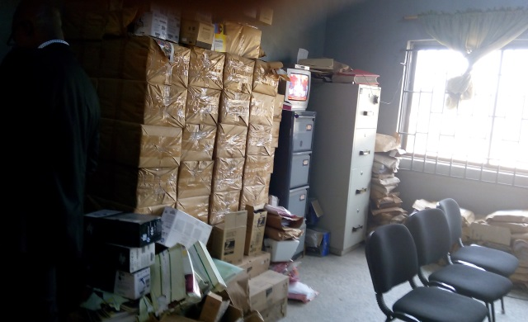
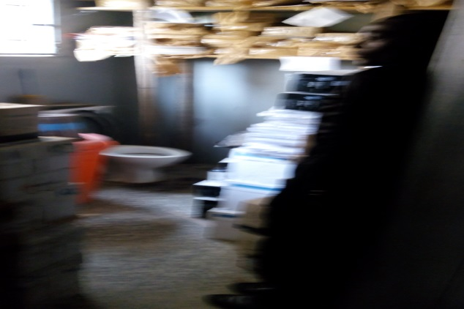
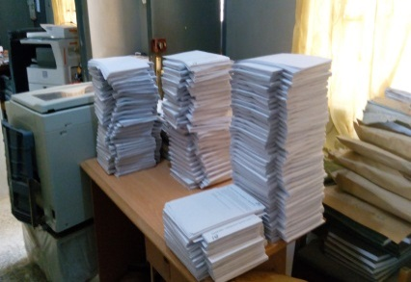

Slide 41
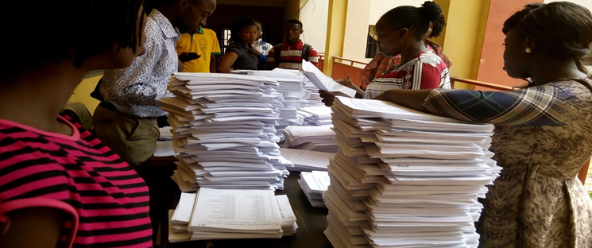
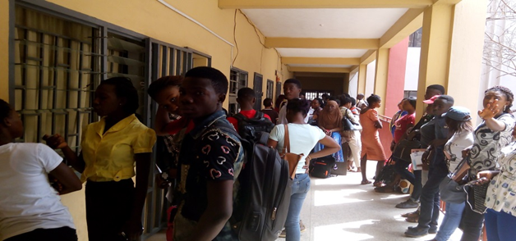

Slide 42



Slide 43


Slide 44
Thank you.
T. O. Fagbemiro
Director, Academic Affairs.
3rd February, 2016.

